Slide 1


Team 8: Project Can-Do
JiaHua Deng
Bryson Herring
Steven Laupus
Timothy Li
Neeti Saluja
Purnachand Simhadri

Slide 2

Investigative Themes
Fundraising by gift frequency
Personal vs. Institutional Giving
Donor Engagement by Contact Type
Efficacy of Special Handling Process

Slide 3

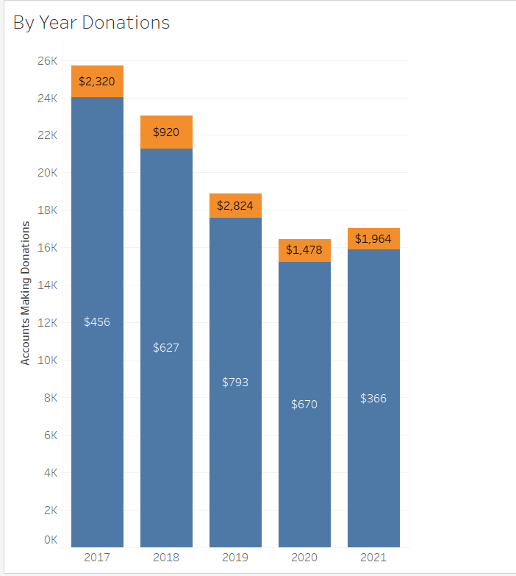
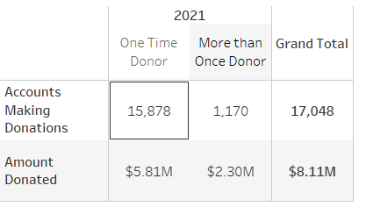
Fundraising Growth/Trends Over Time
At which frequencies have we seen the most gift giving in a 5-year period?
Number of one-time donors heavily outweighs number of repeat donors
Repeat donors still donate a higher amount on average

Slide 4



Fundraising Growth/Trends Over Time
Biggest Household Donors this year:
Frank and Shelley Haughton: $1.04 million (biannually)
Sara Gottesman: $400,050 (one-time)
Kyle Stallings: $100,000 (one-time)
Biggest Organization Donors this year:
Freeport-McMoran Foundation: $1 million (one-time)
Facebook: $164,590 (biannually)
Lamar Advertising: $140,000 (one-time)

Slide 5

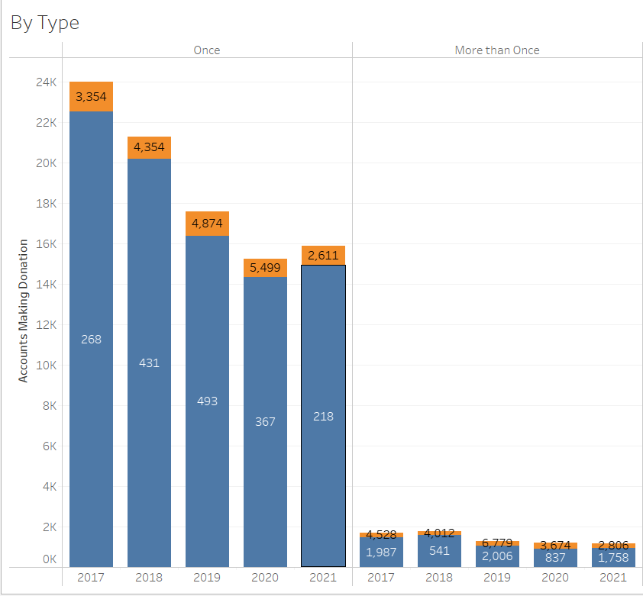
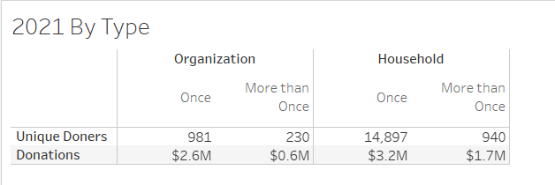
Fundraising Growth/Trends Over Time
At which frequencies have we seen the most personal vs. institutional giving in a 5-year period?
Number of household donations much higher than organization donations
Holds true for both one-time and repeat donations

Slide 6
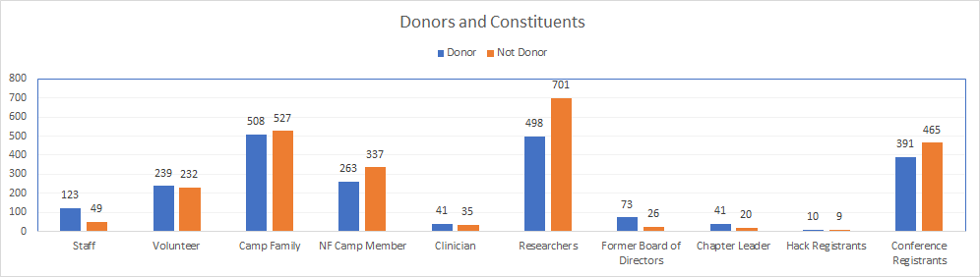
Constituent File Analysis
Who are our donors and constituents?

Slide 7
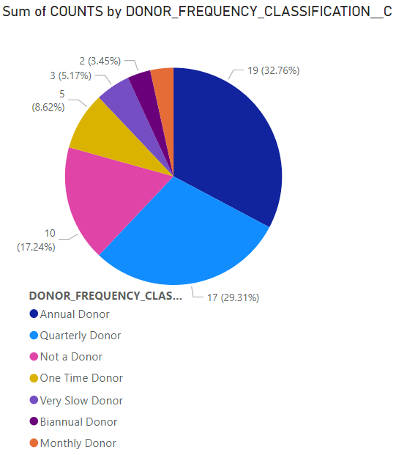
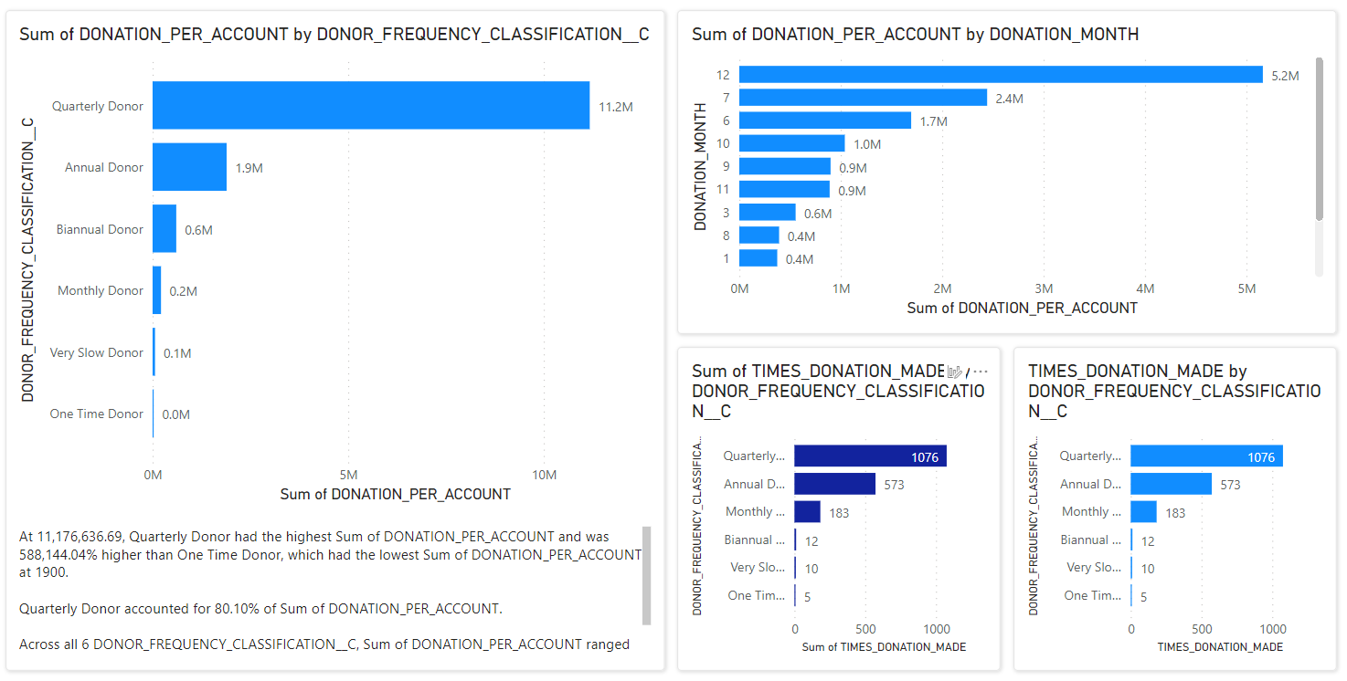
Determinants of Giving
Is there a correlation between Accounts marked Special Handling and giving patterns?

Slide 8


Predictive Modeling Bonus
Using insights, identify donors likely to respond to a gift request in the next 90 days and next 180 days, and predict their gift amount
Observe annual gift metrics of donors to identify if they are ready to give:
Volume of donations per year
Value of donations per year
Compare this information with previous years to identify giving trends
Calculate variance and standard deviation of donations to predict gift amount

Slide 9
Recommendations
One-time donors are the large majority of financial backing
Convert some of these donors to make repeat-donations
Identify similarities in repeat-donors
Analyze 2019 donor data to determine why average donation amount is high
Conferences, volunteers, researchers, and camps make up most of the donations
Find out why percentage of researcher-donors is small
Mid-year (July) and December are the biggest months for donations
Find possible correlation to events/camps/conferences
Emulate those months' conditions and events year-round

Slide 10

Thank you

Slide 11
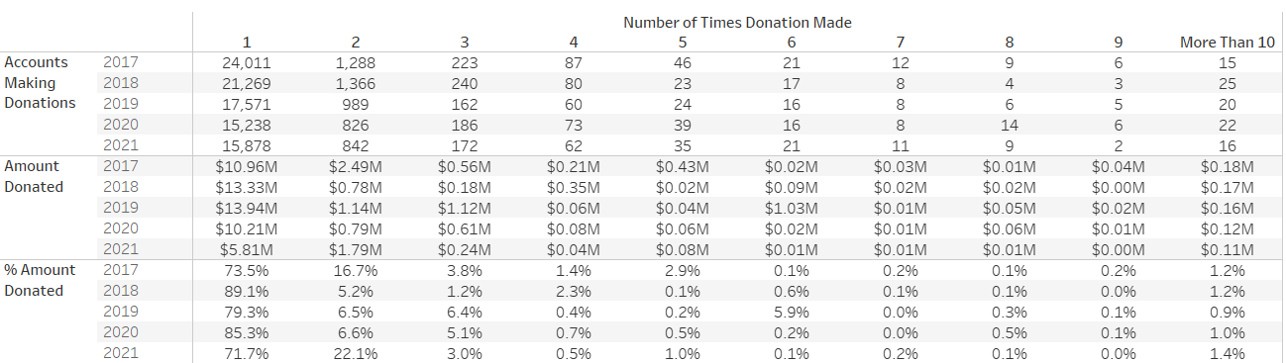
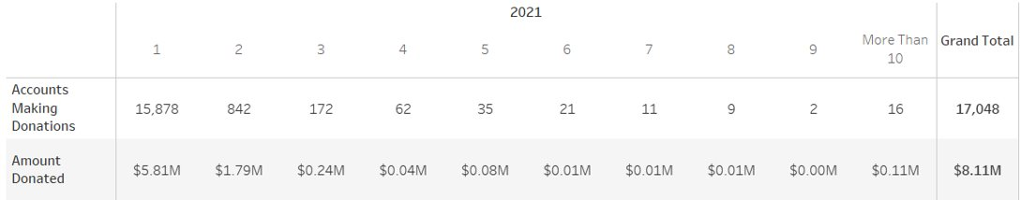
Additional Information (donation frequency)

